Slide 1



NORTHEAST GEORGIA COUNCIL PRESENTS
MEMBERSHIP RENEWAL BASICS
for Packs, Troops, and Crews
Notes:
Welcome and Introduce yourself!
Talk about your role and years in scouting.
Let everyone know in the audience this is the renewal from the Unit's perspective.

Slide 2




UNIT PLAN
BANKING
COMMUNICATIONS
Unit Key 3 plan to determine how National Membership fees will be communicated and paid. Not Unit Fees.
If considering a unit payment option, discuss with your committee the different payment methods.
Verify all unit members (adults and youth) have parent’s email correct in their my.scouting profile.

Slide 3
Part 1:
Unit Member Renewal Process

Slide 4


RENEWAL PROCESS
OVERVIEW
FAMILY
COMMUNICATIONS
Options to customise your unit’s renewal process
Communicating your unit’s process to your families.
KEY 3 RENEWAL STEPS
PAYMENT OPTIONS
Approve Adult and Youth applications that are eligible for renewal.
Paying for membership fees online using credit cards or ACH.

Slide 5
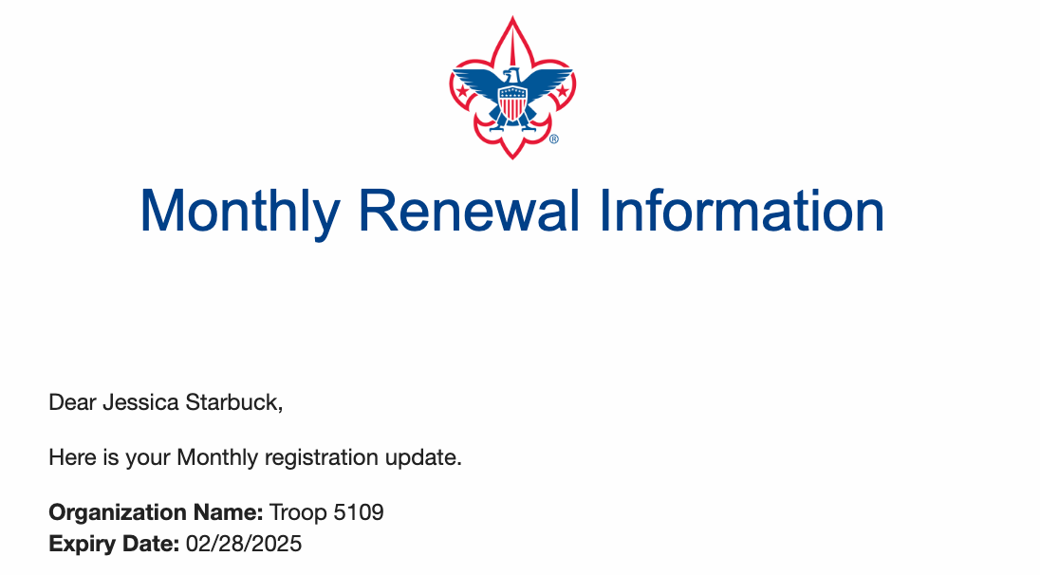

MONTHLY RENEWAL EMAIL
WHO WILL RECEIVE THE EMAIL
Communications to Unit Key 3 Leaders and individual email to eligible families.
WHAT ARE THE TIMINGS?
Unit Members will be eligible to renew up to two months prior and one month after.
HOW CAN I TELL A UNIT MEMBER’S STATUS?
Status will be indicted in unit roster on My.Scouting.org.

Slide 6
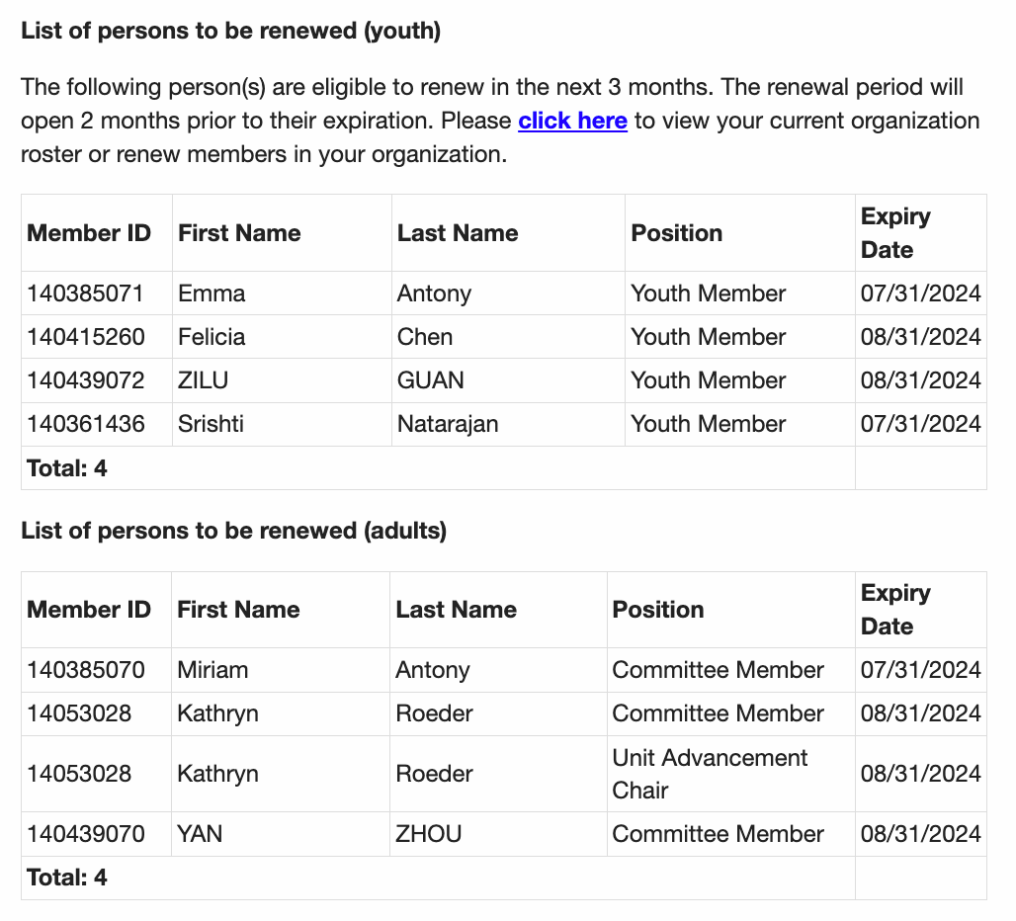
PERSONS TO BE RENEWED

Slide 7
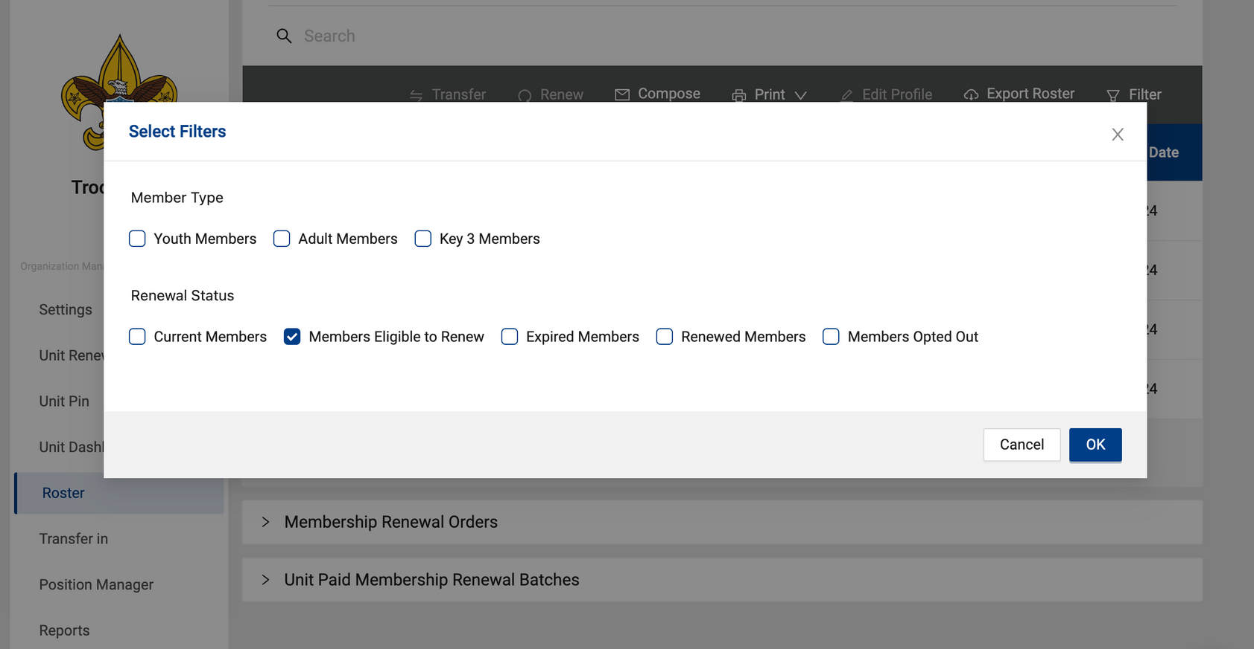
ACCESS THROUGH MY.SCOUTING
LOG IN TO MY.SCOUTING
Select the organization unit you wish to manage,
ROSTER
Select the Roster Tool for the desired unit.
MEMBERS ELIGIBLE TO RENEW
Click filter and check the “Members Eligible to Renew” box.

Slide 8
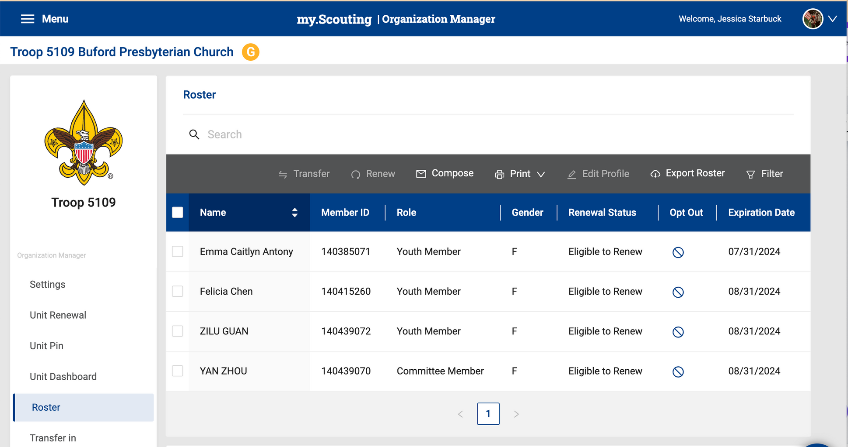

ROSTER: MEMBERS ELIGBLE TO RENEW

Slide 9
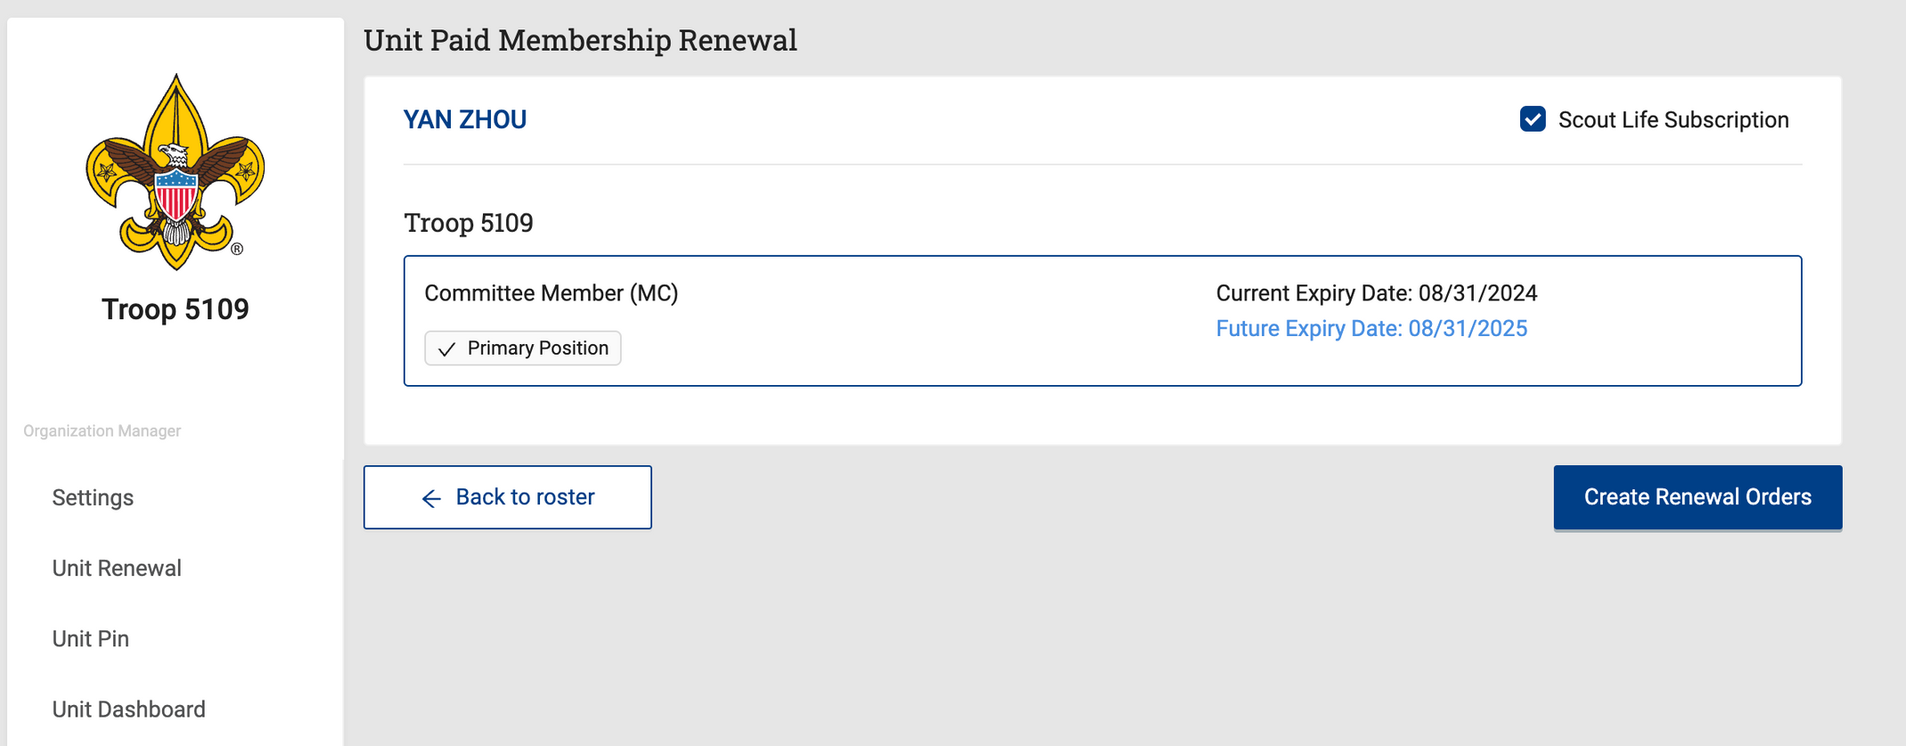
ADULT RENEWAL FORM

Slide 10
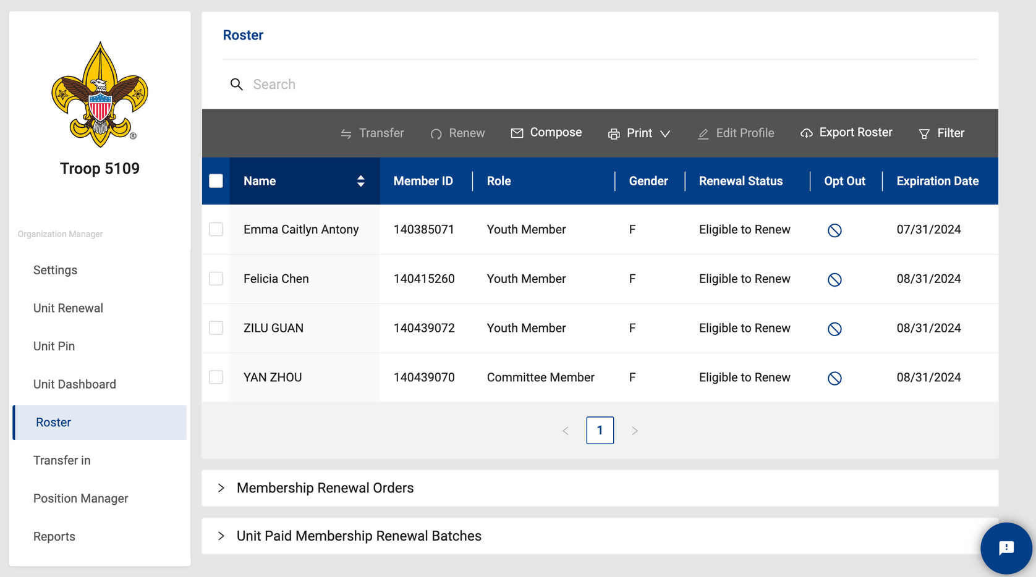
CREATING AN ORDER

Slide 11
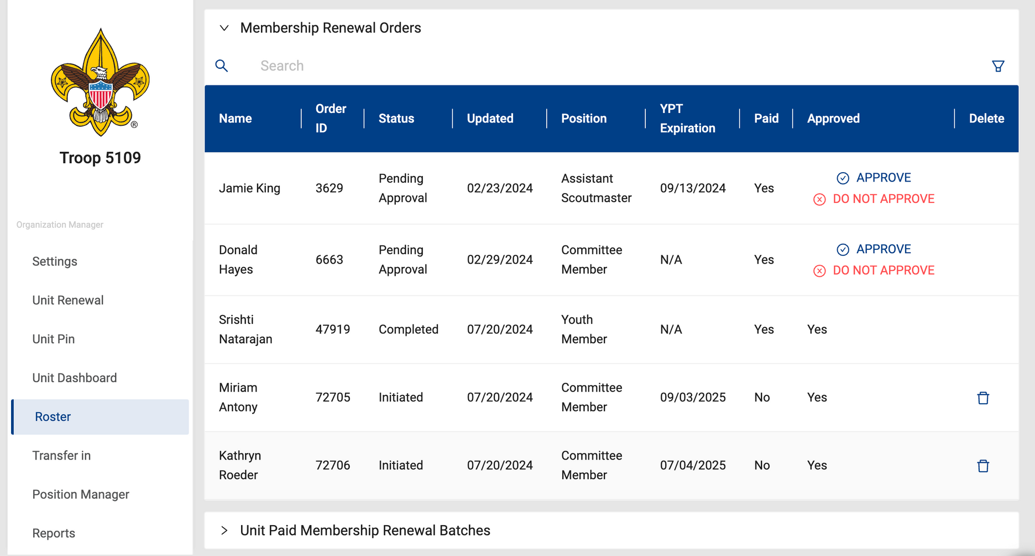
CREATING AN ORDER
Approve by clicking option

Slide 12
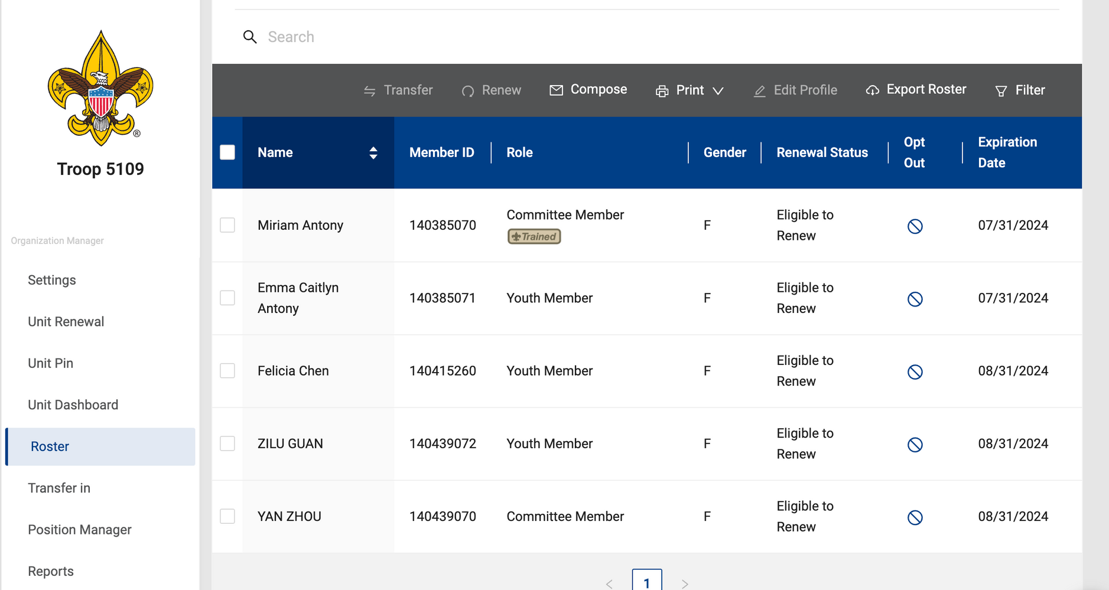
MODIFYING AN ORDER

Slide 13
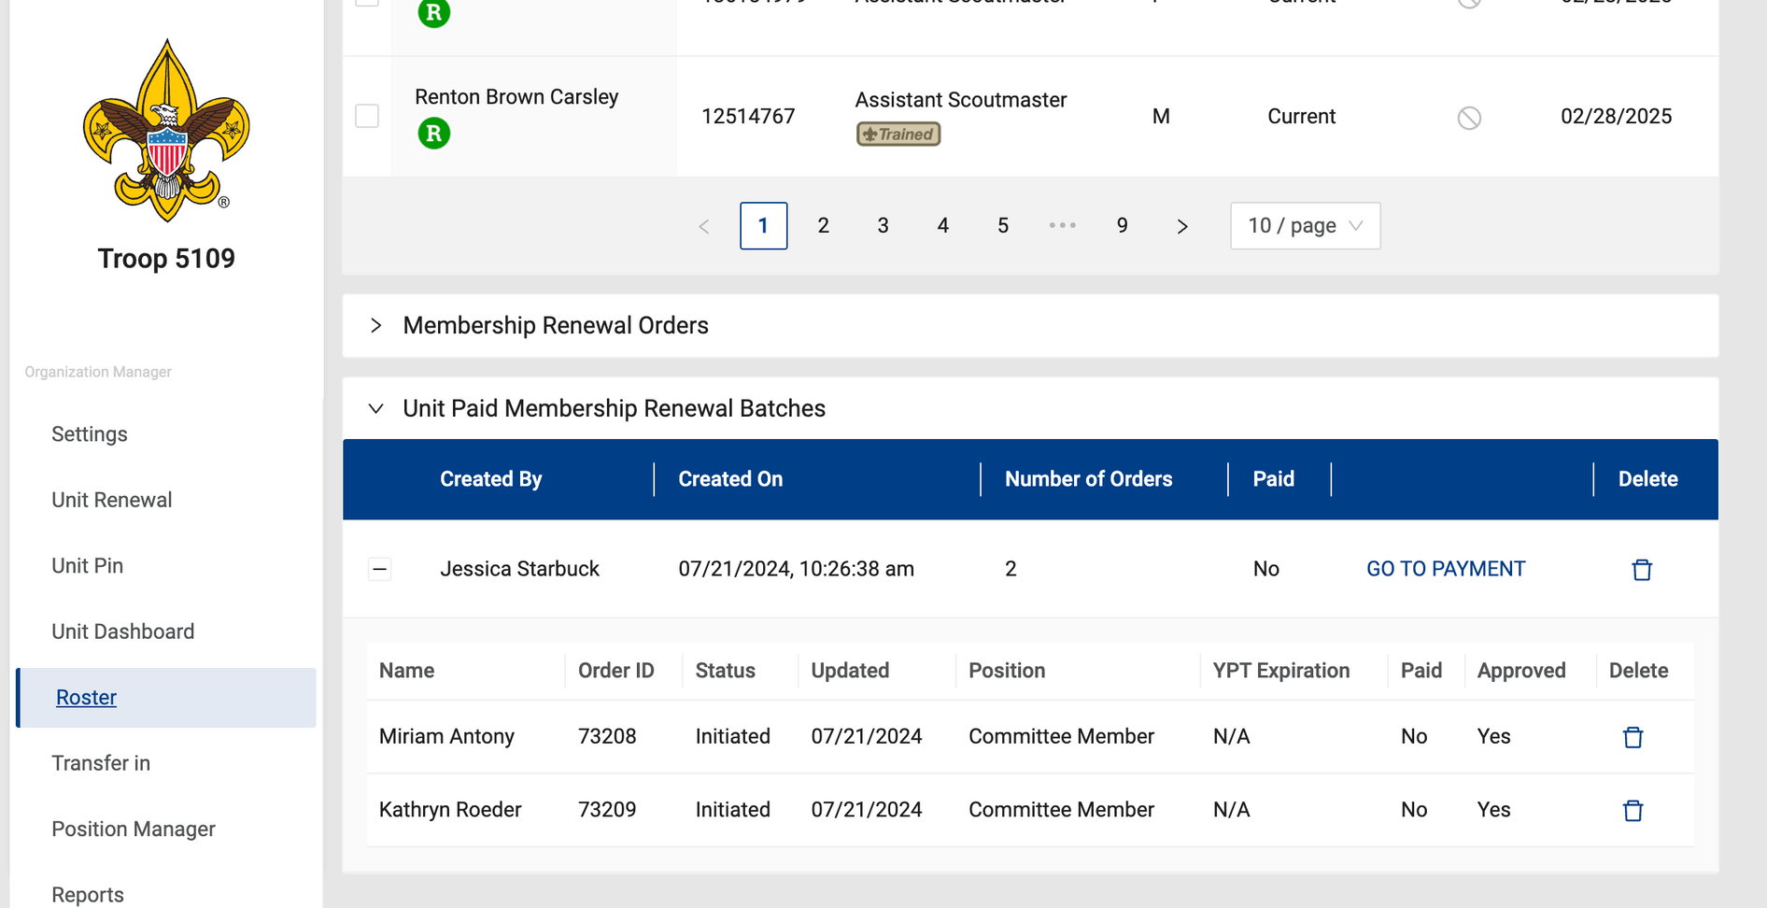
ORDER

Slide 14
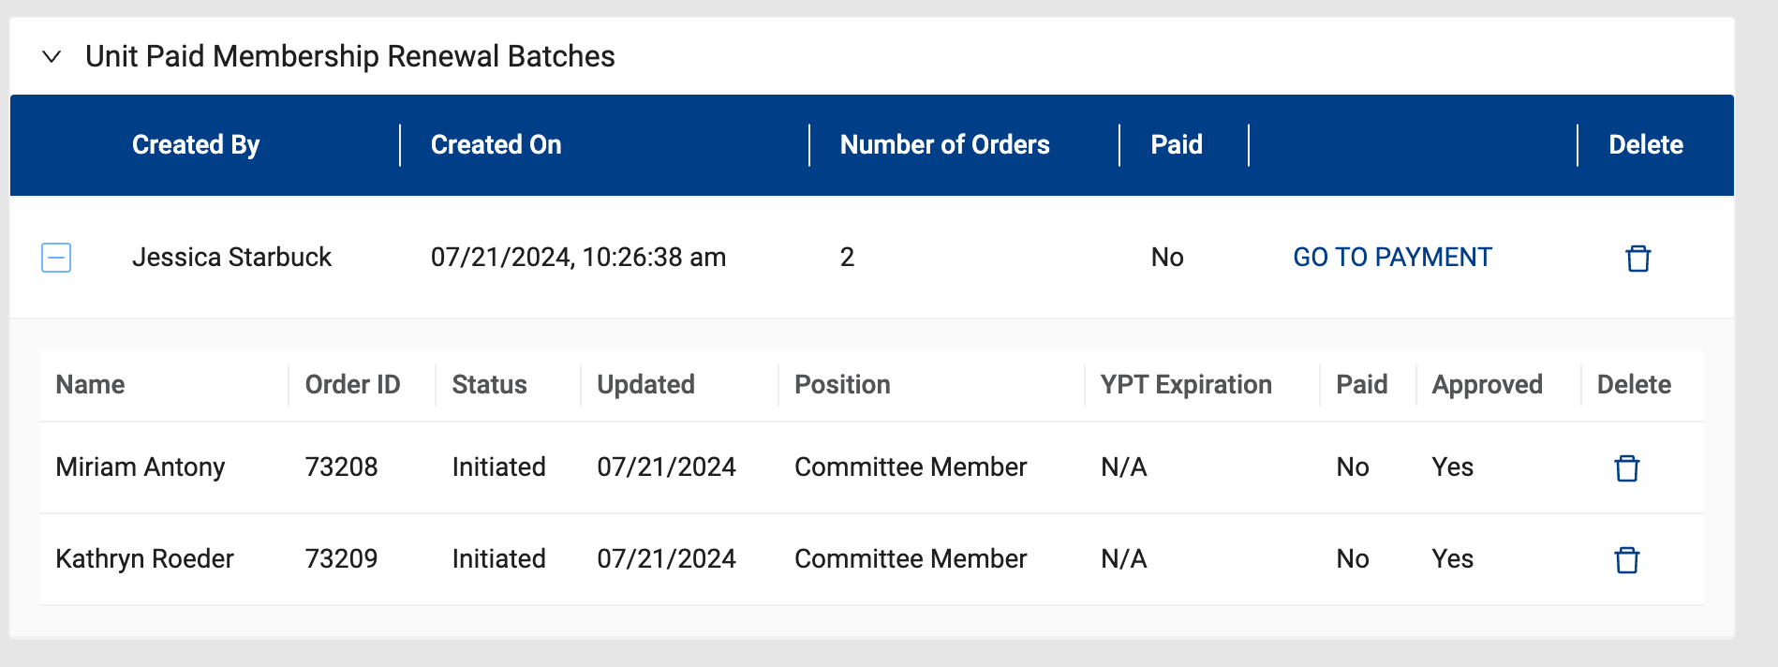
RENEWAL BATCHES

Slide 15
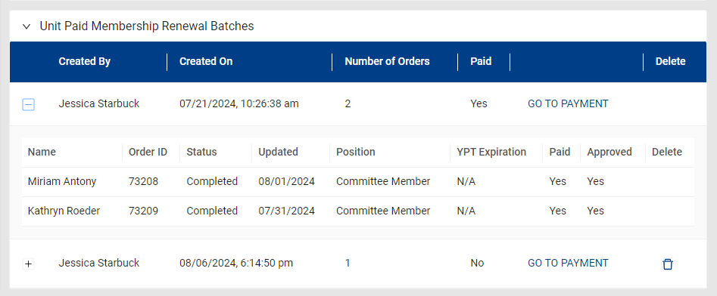
ORDER CONFIRMATION

Slide 16
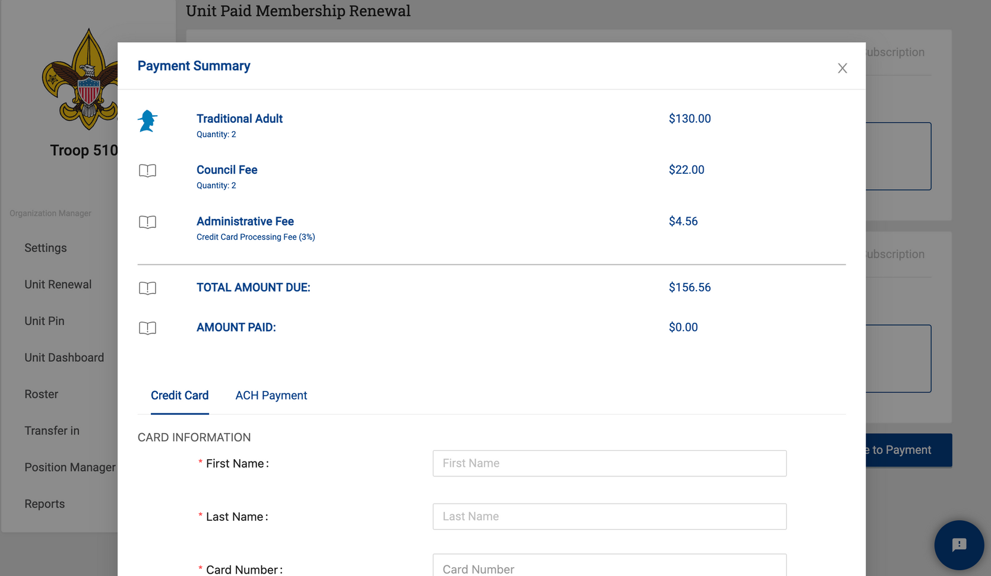
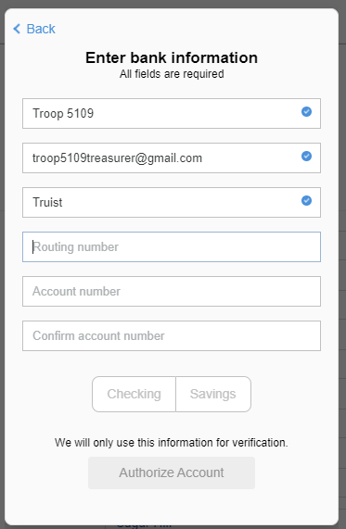
PAYMENT SELECTION
Insurance no longer pro-rated - $11 per application
3% for CC payment or $1 flat fee for ACH payment
Name on Account
Email Address
Select Payment Option by Selecting the Title
Bank Name
Routing Number
Account Number

Slide 17
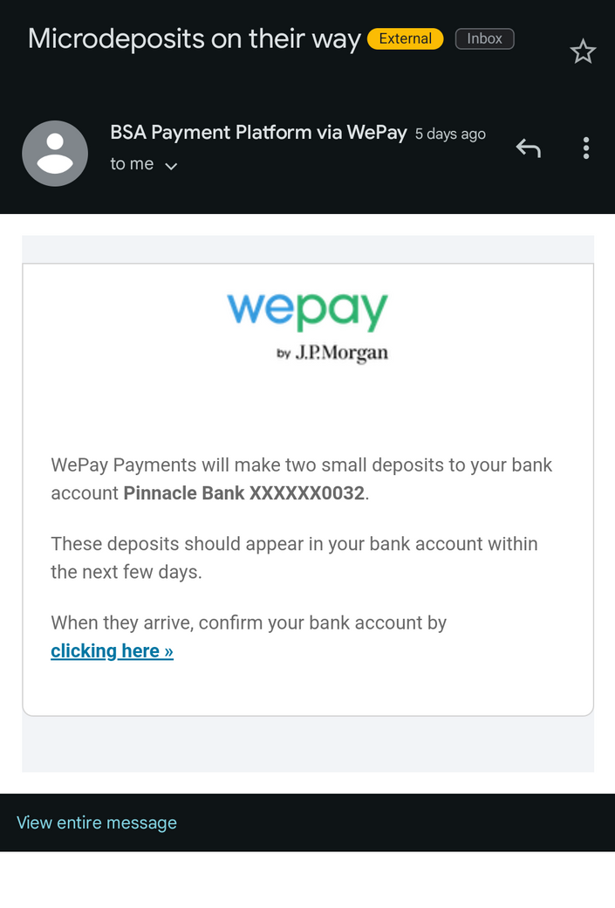
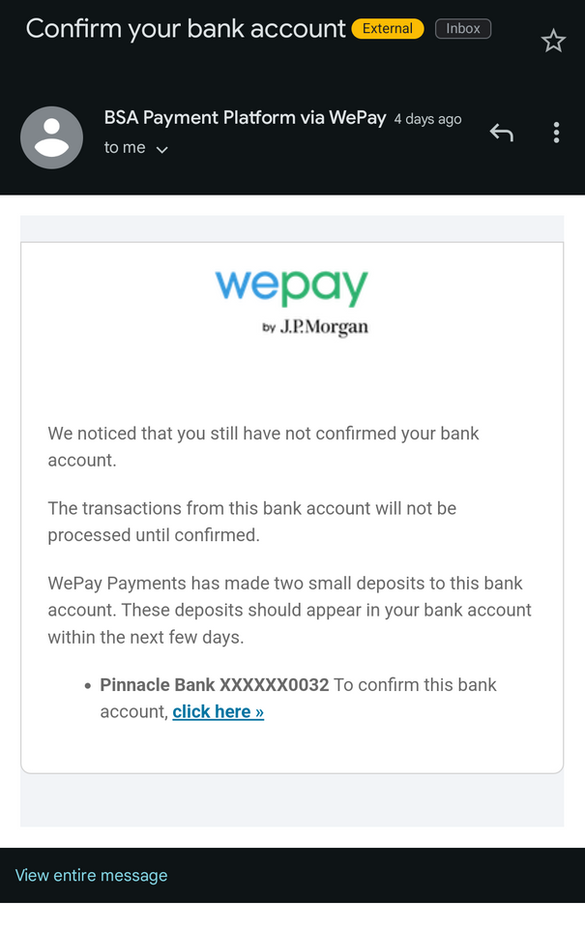
ACH CONFIRMATION
Check your spam folder for the original email.
Thist email gets sent if you have not yet confirmed your account.
Confirm this is the correct last 4 of your account Number
Bank Company Name
XXXXX1234
Bank Name
XXXXX1234
Once you receive the transactions, click here to confirm amounts

Slide 18
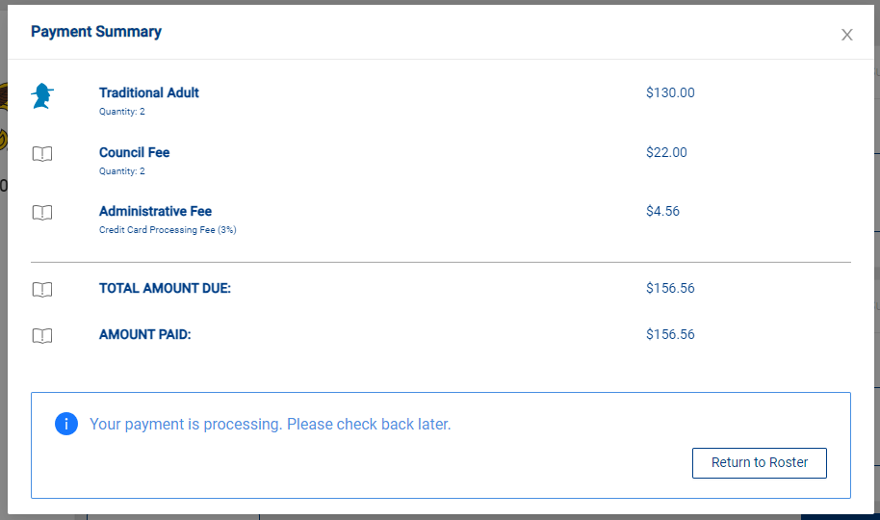
PAYMENT SUMMARY

Slide 19
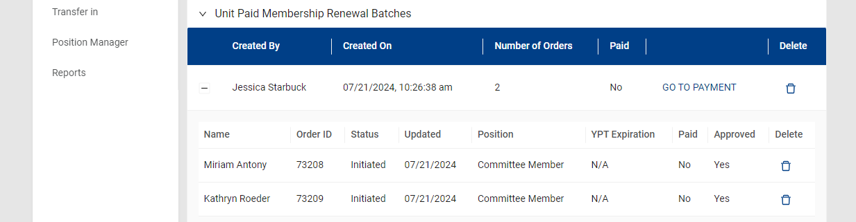

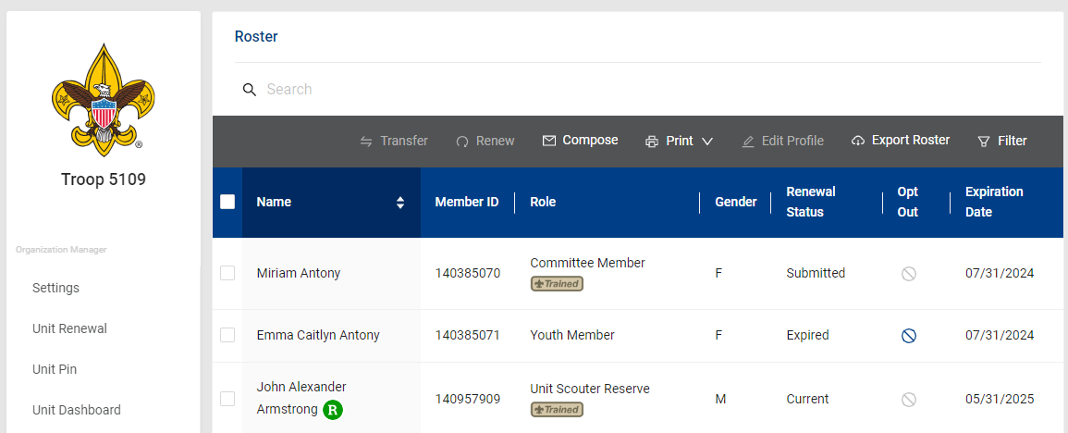
BE PATIENT!
RETURN TO ROSTER
Just like you left it!
Does not update right away
UP IN THE MAIN ROSTER
Renewal Status says Submitted

Slide 20
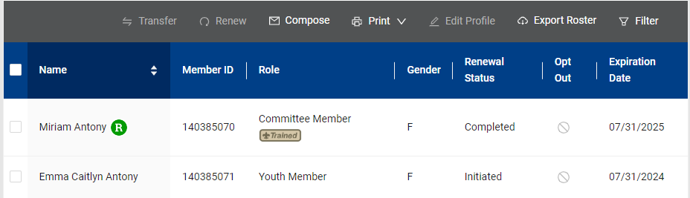
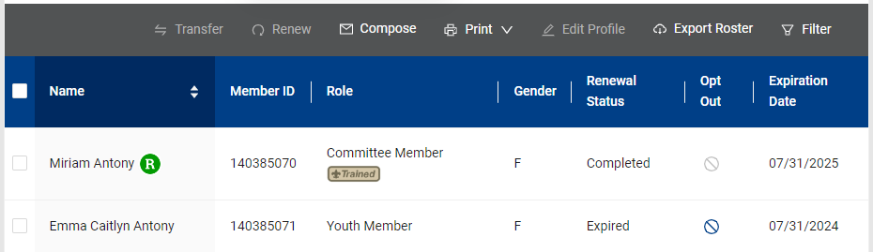
RENEWAL STATUS PHASES
RENEWAL STATUSES
Eligible to renew
Initiated
Submitted
Completed
Expired

Slide 21
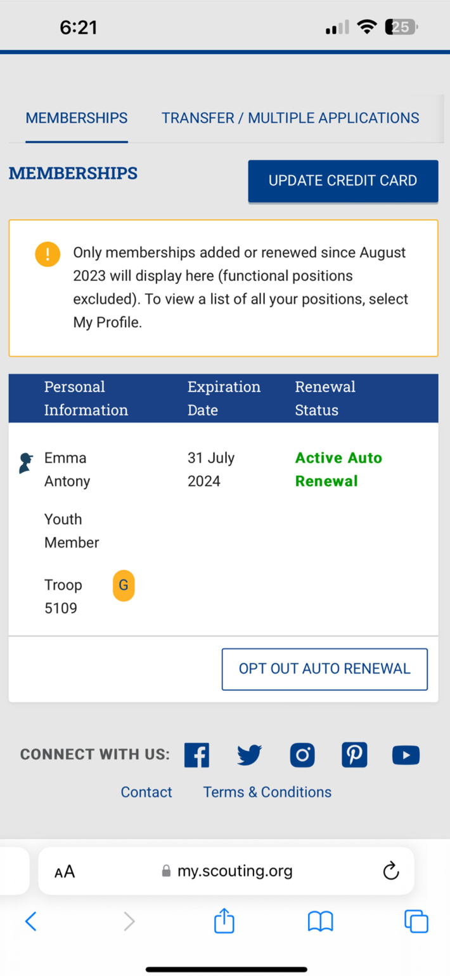
ACTIVE AUTO RENEWAL
PARENT VIEW
AUTO RENWAL - FAIL SAFE
NOT A PRIMARY PAYMENT
ACTIVE AUTO RENEWAL DOES NOT AUTOMATICALLY RENEW YOUR SCOUT ON THEIR EXPIRATION DATE!!!

Slide 22
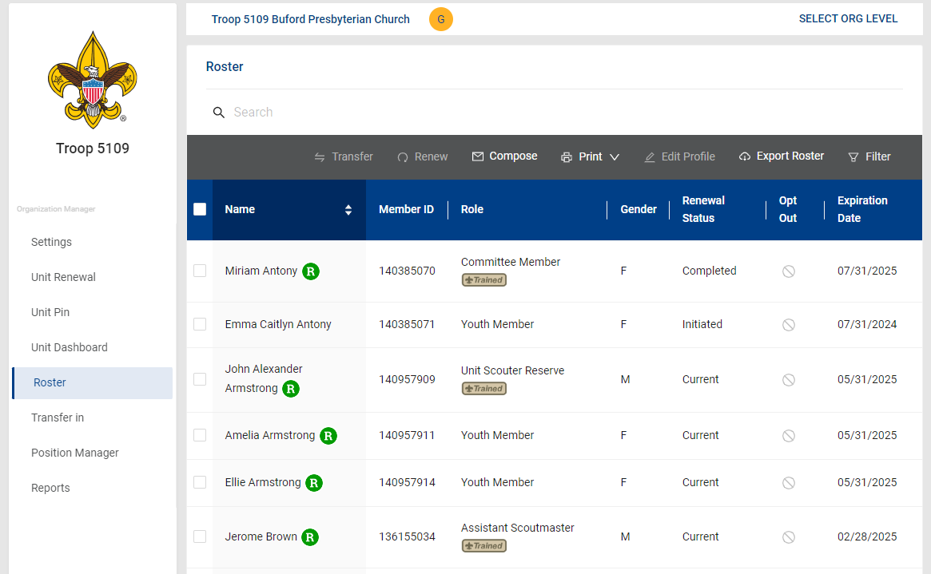
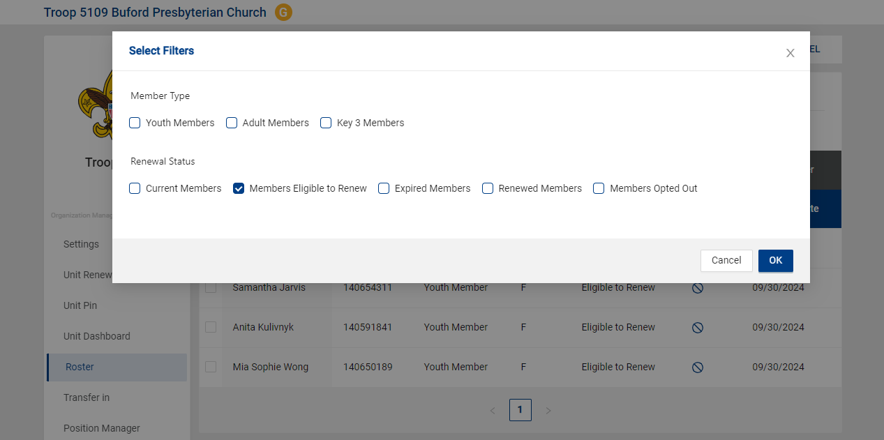
COUNCIL PAYMENT OPTION
Select the Filter Button
Select this option

Slide 23
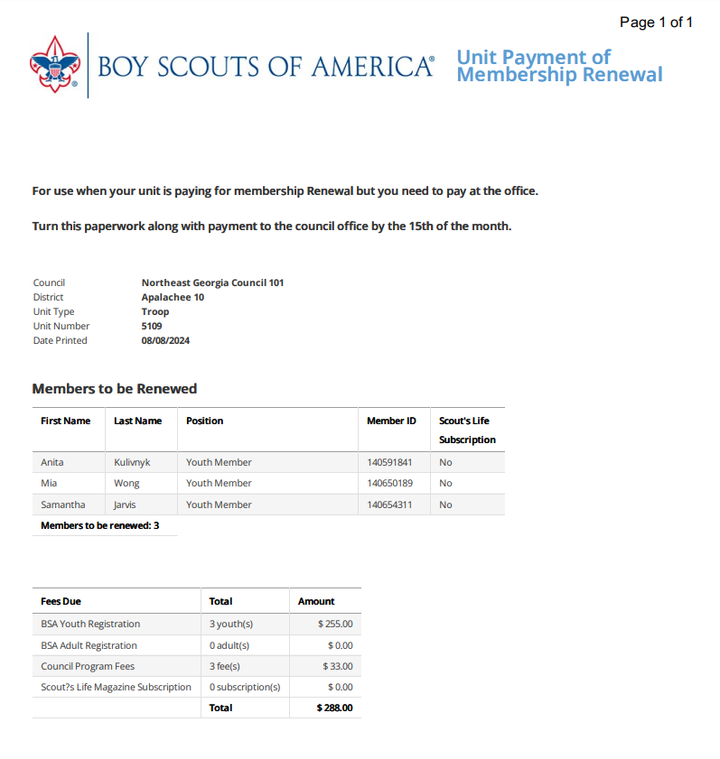
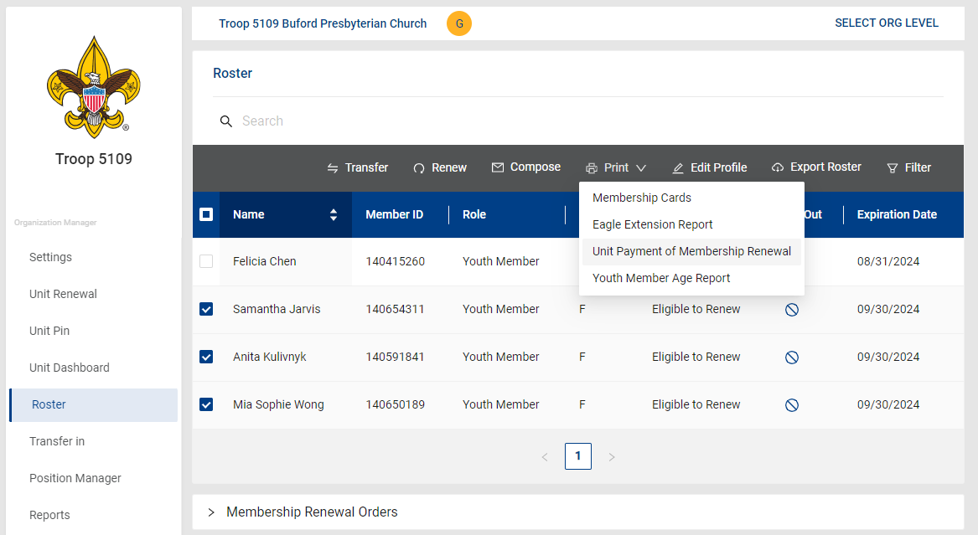
Then click on the Print Tab
Once accurate, submit this to either the
Lawrenceville Service Center
or the Jefferson Service Center
Select This
Confirm Accuracy of these
Select the youth and adults to renew

Slide 24
WHAT ARE THE IMPORTANT THINGS TO REMEMBER?
  UNIT RENEWAL PLAN
  COMMUNICATE WITH FAMILIES
  MONITOR UNIT FUNDS
  CHECK EMAIL ADDRESSES
  MORE COMMUNICATION
  EVEN MORE COMMUNICATION

Slide 25

QUESTIONS

Slide 26
NATIONAL TOOLS
BSA Unit Membership and Renewal
BSA SOURCES

